Slide 1
a/λ>>1
optics
a/λ>>1
Geometrical optics
Wave optics
diffraction
(physical optics)
The light travel in straight line paths or rays.
Mirrors and Lenses
Interference
Image formation by mirrors and lenses

Slide 2
Chapter 41 Interference

Slide 3
Two-source interference
+1
t
-1
+
In Phase
+1
t
-1
+2
Constructive Interference
t
-2

Slide 4
+1
t
-1
+
+1
Out of Phase
180 degrees
t
-1
+2
Destructive Interference
t
-2

Slide 5
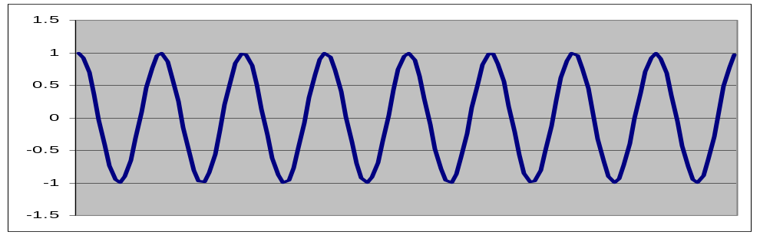
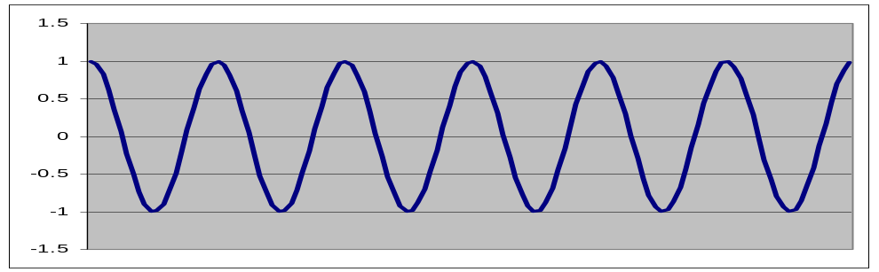
+
Different f
2.5
2
Non-interference
1.5
1
0.5
0
-0.5
-1
-1.5
-2

Slide 6


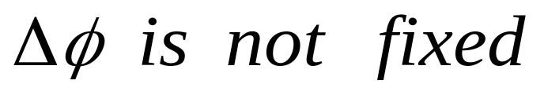

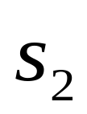
Interference Requirements
Need two (or more) wave
Must have same frequency and same polarizing direction
Must be coherent (i.e. waves must have definite phase relation)
Need two waves from single source taking two different path

Slide 7
Two slits
Two different paths
Interference possible here
Single source

Slide 8
Reflection
Two different paths
Interference possible here
Single source

Slide 9
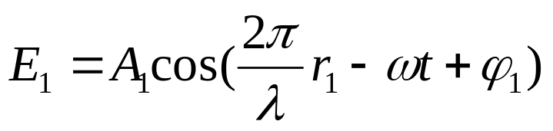






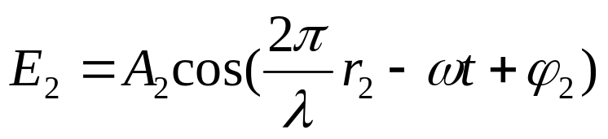

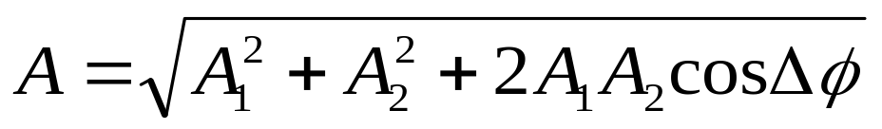
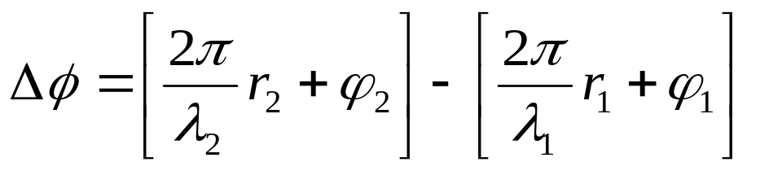
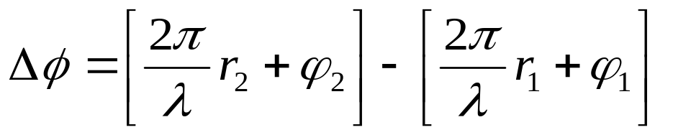

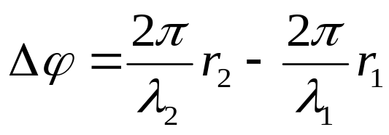
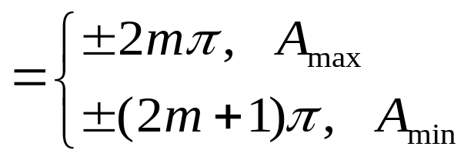
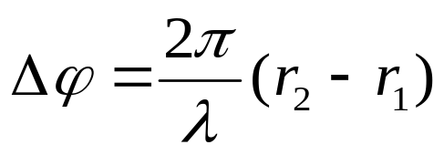
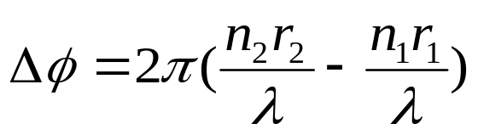
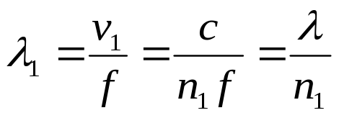
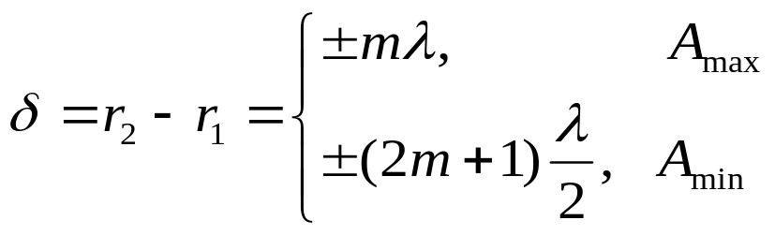
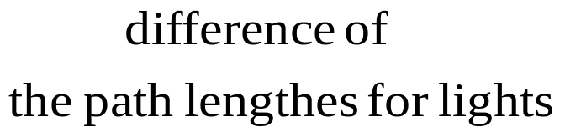
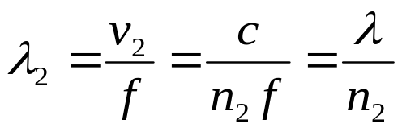
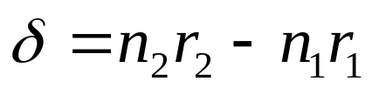
in a medium
Difference of Optical Path Length

Slide 10





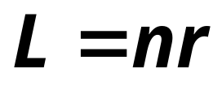


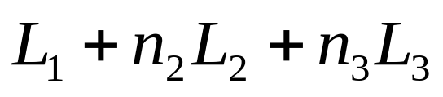
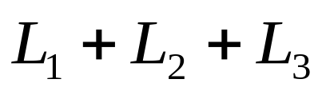
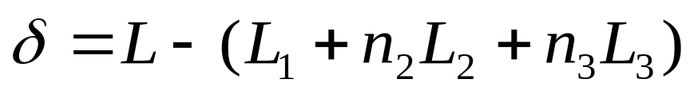
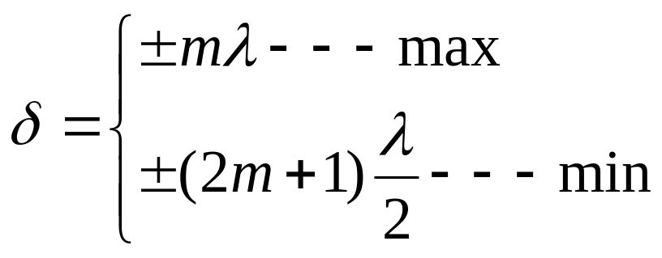
 Optical Path Length
The path length
The optical path length
Difference of the optical path lengths:

Slide 11
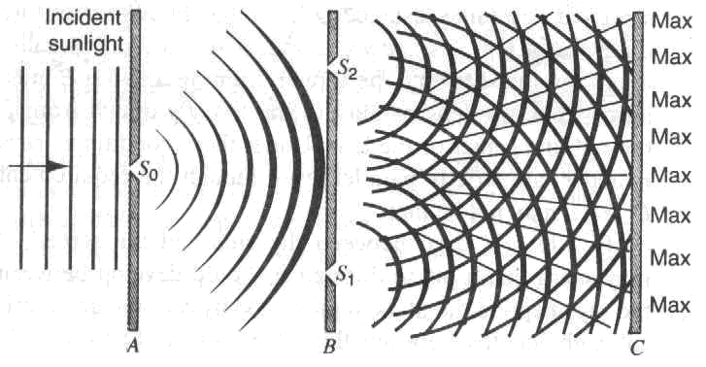
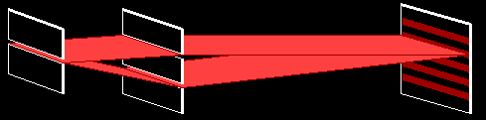
Double-slit interference
d
Single source of monochromatic light λ
Young’s double-slit experiment
D

Slide 12
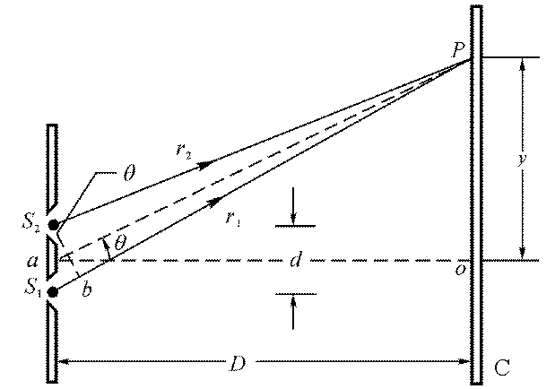
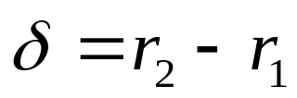
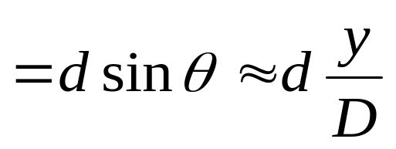
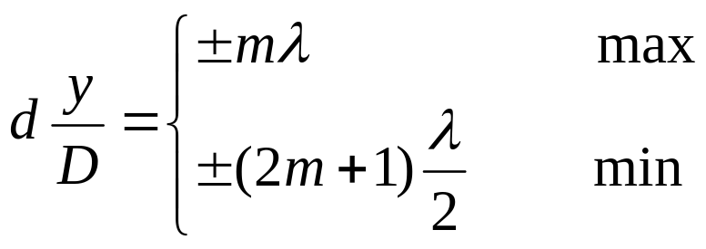
Double-slit interference
Difference of Optical Path Length
d sin θ = m λ
If λ > d then λ / d > 1
so sin θ > 1
Not possible!

Slide 13

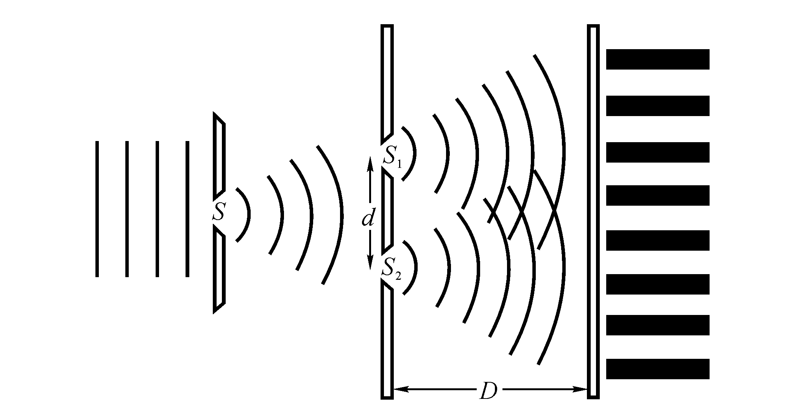



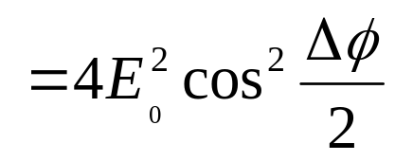

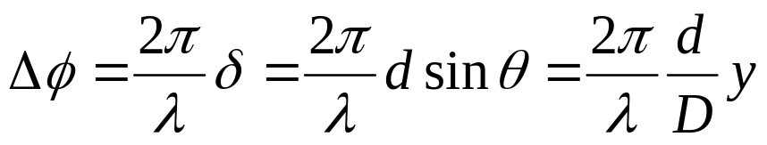
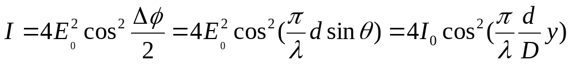
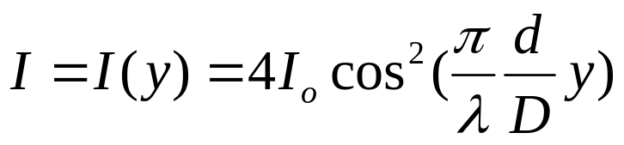
Completely coherent light: the resultant maximum intensity is four times the individual intensity.
Intensity in double-slit interference
 The intensity distribution
Completely incoherent light: the resultant intensity is equal to the sum of two individual intensity.

Slide 14

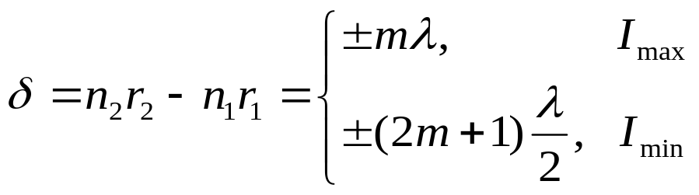
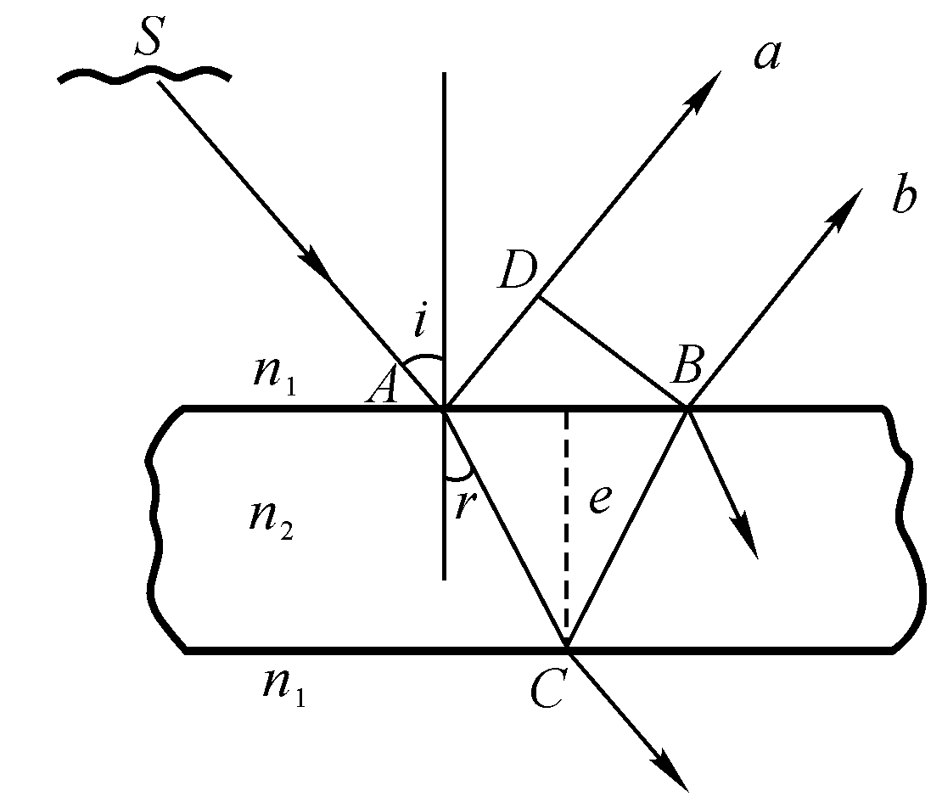
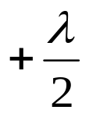
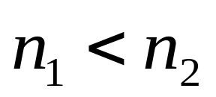
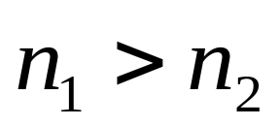

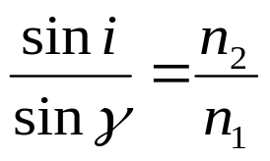



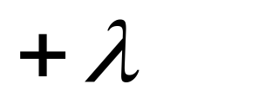
Interference from thin film
Phase change in reflection

Slide 15
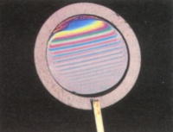
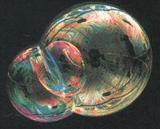
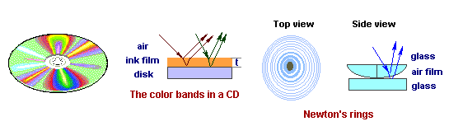

Slide 17
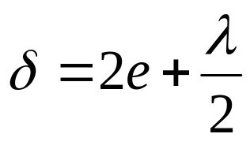
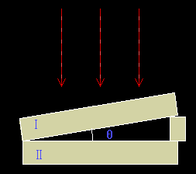

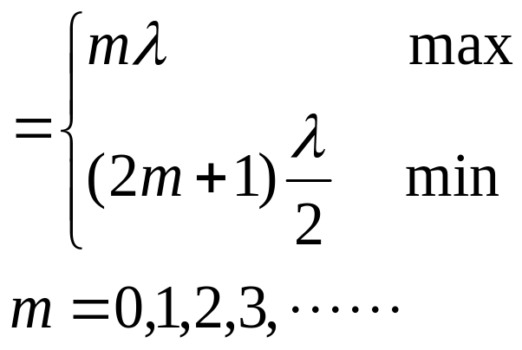


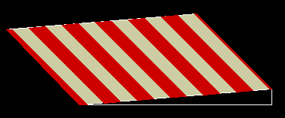
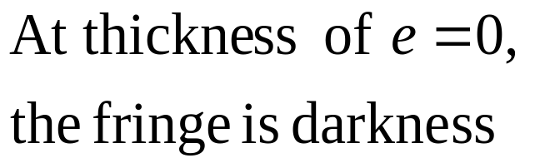
The sharp wedge:

Slide 18
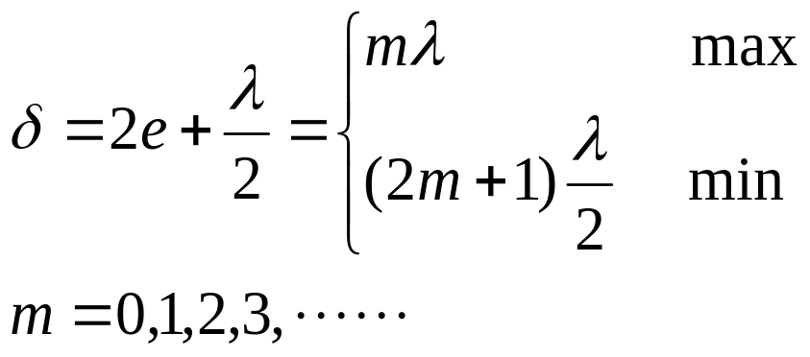









The Newton’s ring:

Slide 19


 phase changes on reflection

Slide 20




Increasing reflection
Glass n=1.50
Increasing reflection
Glass

Slide 21




Michelson’s interferometer
Constant angle interference:
Originally built in 1881 for proving if the ether, the medium of the light
n₁
n₂
However there was no observable fringe shift!
Speed of light is dependent on the ether
There no the ether!

Slide 22
The interference happens on the conditions of (1): Same frequency, (b): Electric vectors in same direction, and (3) Coherence (fixed phase difference)
Visible light: 400nm—700nm
Coherence of time
Atomic emission: lifetime: 10⁻⁸ s
wavetrain: about 1~10 m
coherent length

Slide 23




coherent length of two coherent waves L_{c}
Monochromic light—laser
Coherent of space
critical width of light source

Slide 24













Example
As shown, two optical medium plates with same thickness of d placed at the back of the two slits, and the 5th maximum fringe shifted to the central. Find the thickness of the plates.

Slide 25













Example

Slide 26





Example
h

Slide 27




Example
Yellow light (wave length = 589 nm) illuminates a Mechelson’s interferometer. How many bright fringes will be counted as the mirror is moved through 1.0 cm?
d

Slide 28
Exercises
P958-960 15, 25, 38
Problems
P961 4, 7

